Slide 1

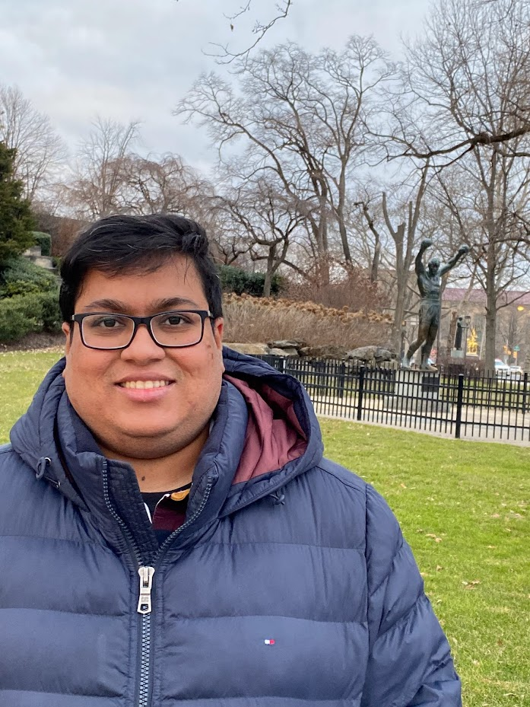

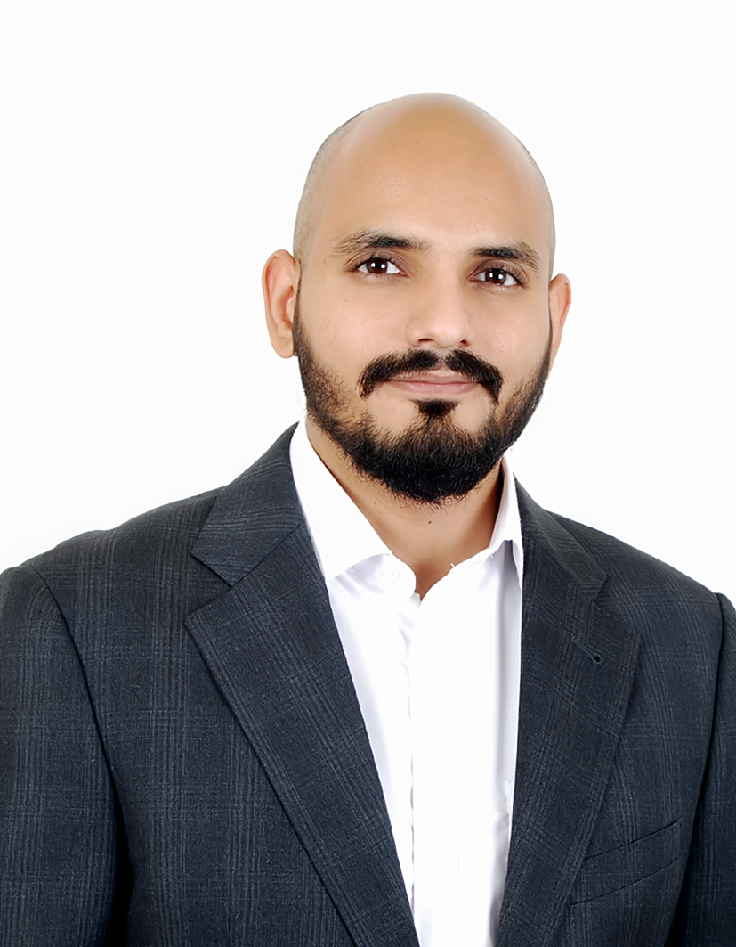




Presented By -
Group 11
Avinash Vishala Nagaraja – Project manager/ Team Led
Abhishek Verma
Shubham Tiwari
Vedang Thakur
Tengyang Wen

Slide 2


Agenda
Problem Statement
Idea
Research Questions
Features
UI Design

Slide 3
Problem Statement
Track Medical History
Time and effort
Accessibility
Schedule
Convenience

Slide 4

Idea
Use mobile technology and NFC tags to store, transfer and view health records.
No need for conventional ways to find prescriptions and medical reports on different platforms.
One stop solution for all your medical needs.
All medical information at a click of a button.
Secure API interface and linked with all hospitals and pharmacies to interact with DigiCare.

Slide 5
Research Questions
How can we make the user interface interactive for people of all age groups?
How can I track my schedule to manage my prescription tablets?
How can I find the nearest hospital in my area?
How can I manage my diet as per the doctor’s prescription?
How can I send an emergency alert?
How do I manage my appointments?

Slide 6

Features
A personalized digital vault for all customers to store medical information.
Information on nearby hospitals, availability of doctors, hospital rating, and insurance accepted.
Emergency Button with location sharing for faster deployment.
Personalized diet recommendations based on medical records.
Book an appointment with the hospital and pharmacy.
Reminder notifications and tracking medicine schedule.
Showcase Alerts based on heart-rate monitoring to family members and alert emergency services if required. (Require device for tracking heart activity)

Slide 7
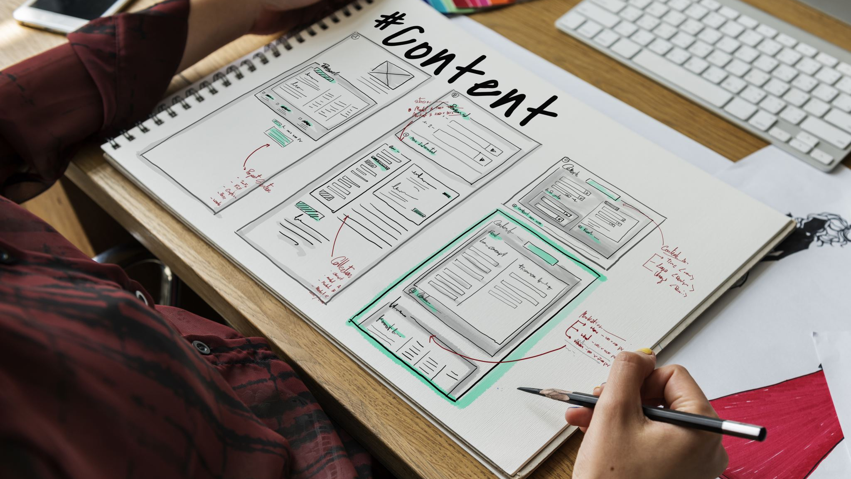
UI Design

Slide 8

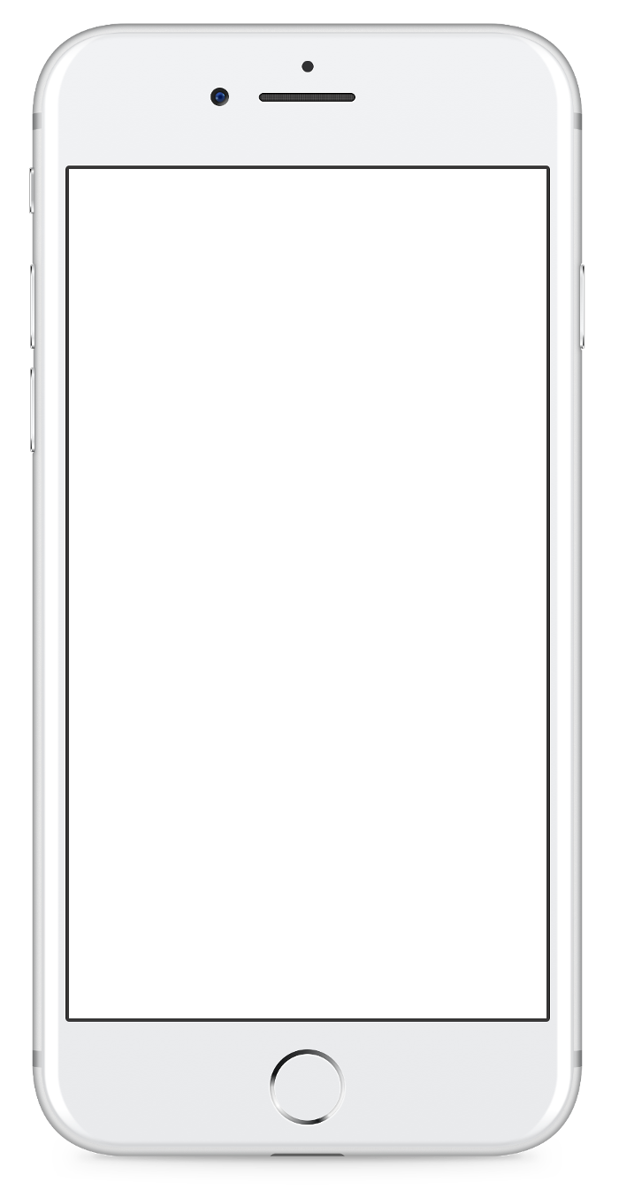
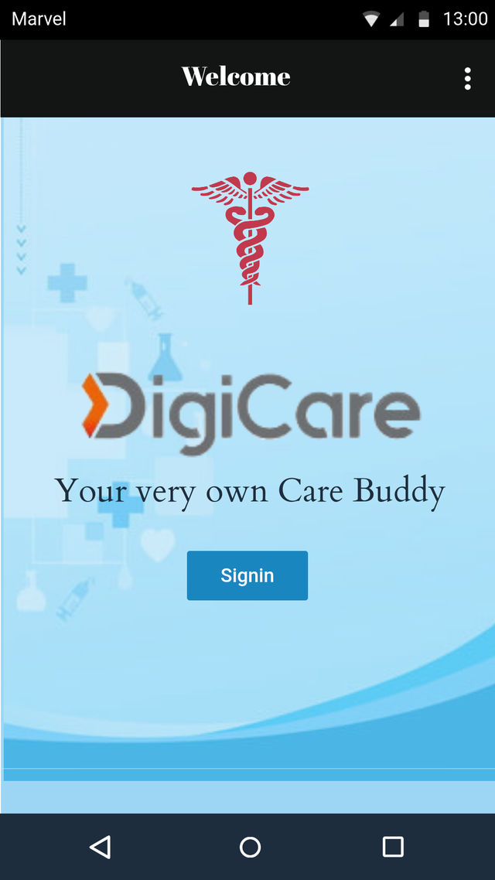
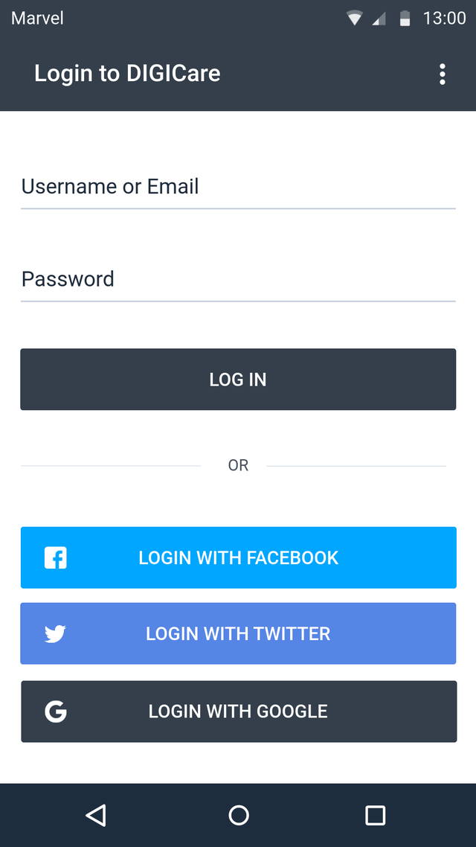
Login/Signup Page
Convenient ways to log in, with multiple integration by adding icons for the popular social media platforms like Google, Facebook and Twitter.
User Friendly UI design to navigate easily
login and signup screens are optimized for mobile/Web devices
login and signup input fields simple and easy to use

Slide 9

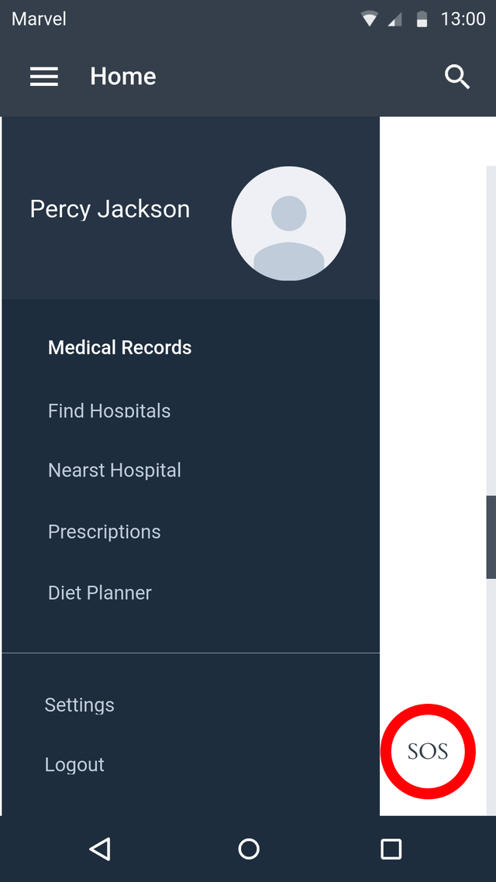
Main Menu/Home
Quick access to frequently used features
Offer users the ability to customize the Home screen with their preferred settings, shortcuts, or widgets.
Provide a prominent search bar on the Home screen, allowing users to quickly search for content or information within the app or website.
Consistency and hierarchy

Slide 10

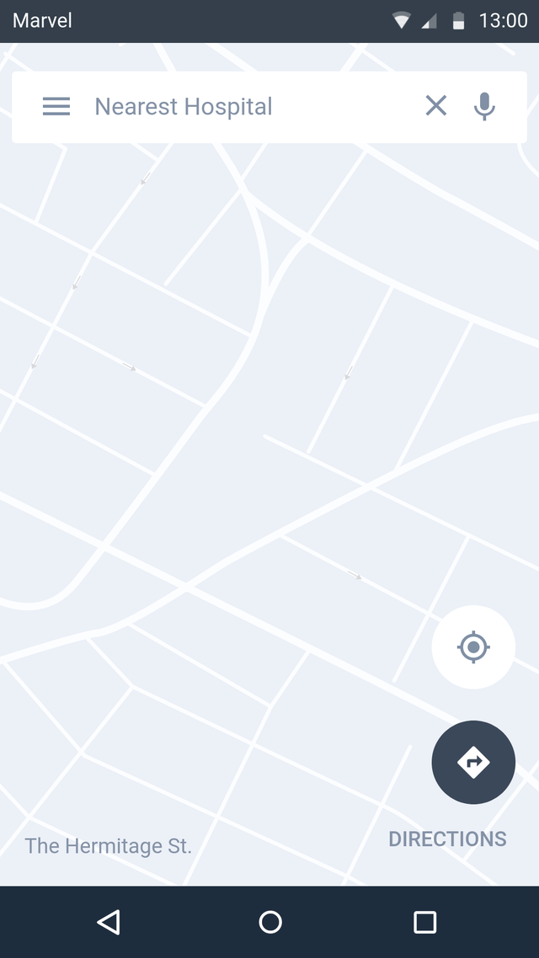
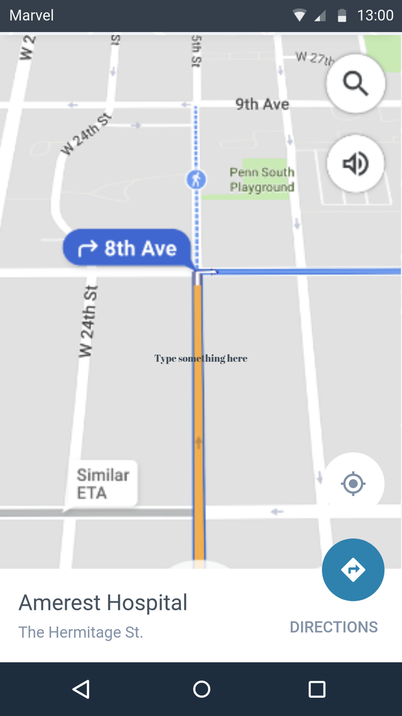
Find Hospital
Find Nearest Hospital
Navigate to Hospital

Slide 11
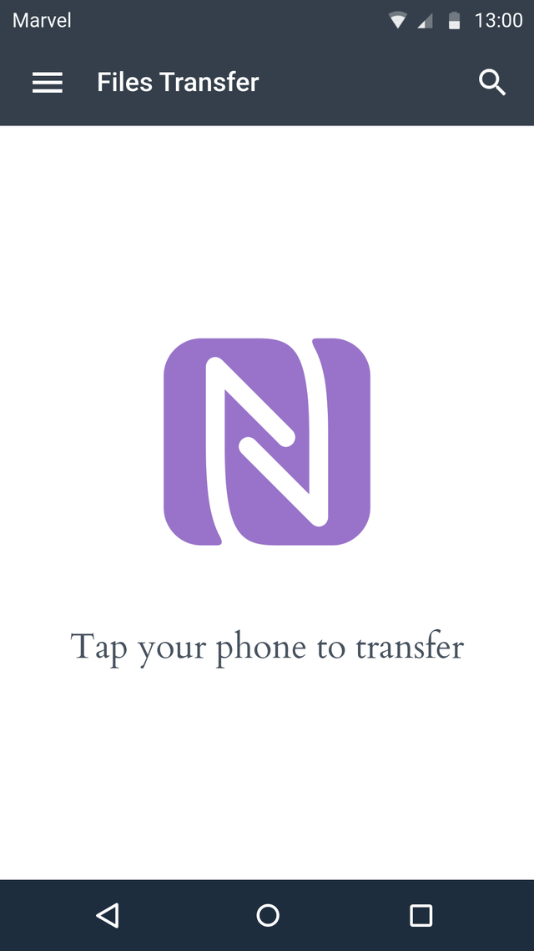
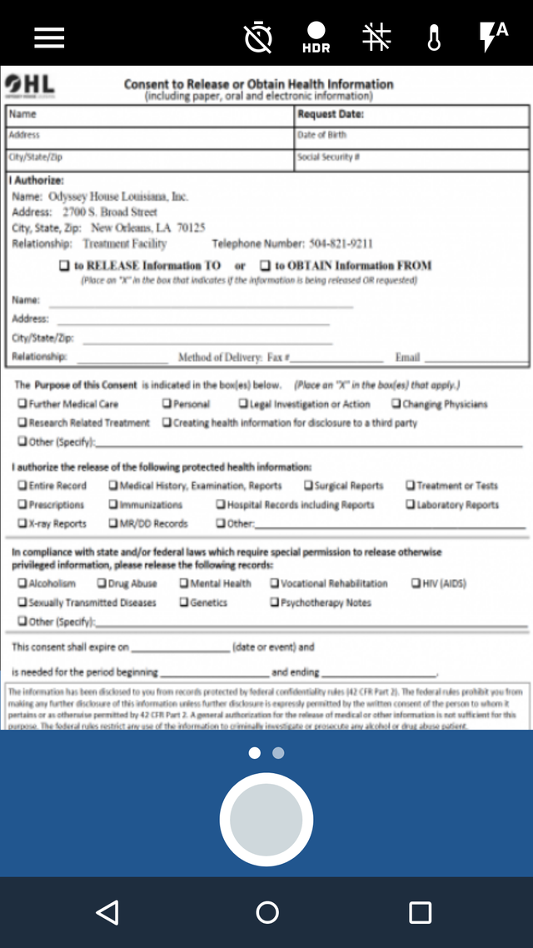
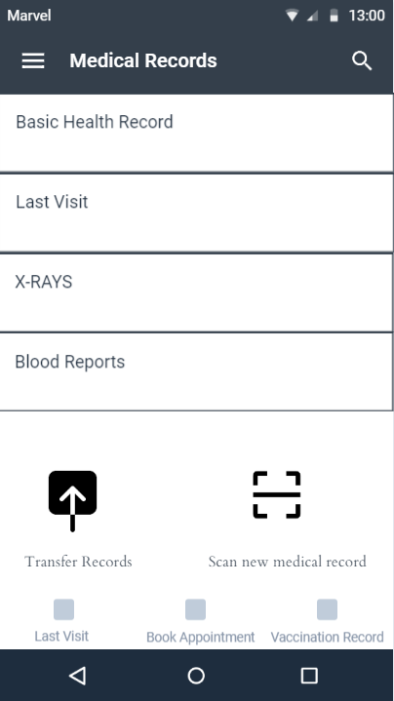
Medical Records
Transfer Medical History
Scan Paper based records
View Reports

Slide 12

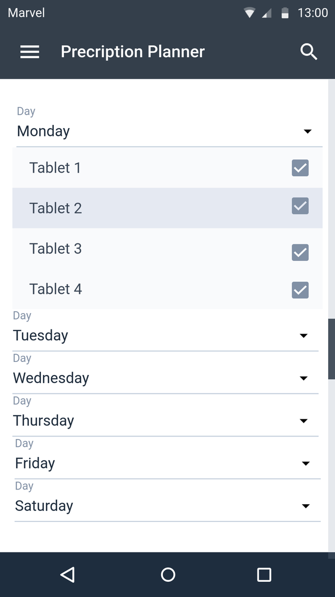
Prescriptions Planner
Notification Alerts.
Cumulates prescriptions of doctors.
Option to add/drop reminders.

Slide 13

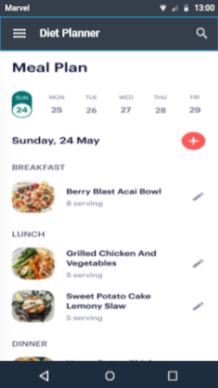
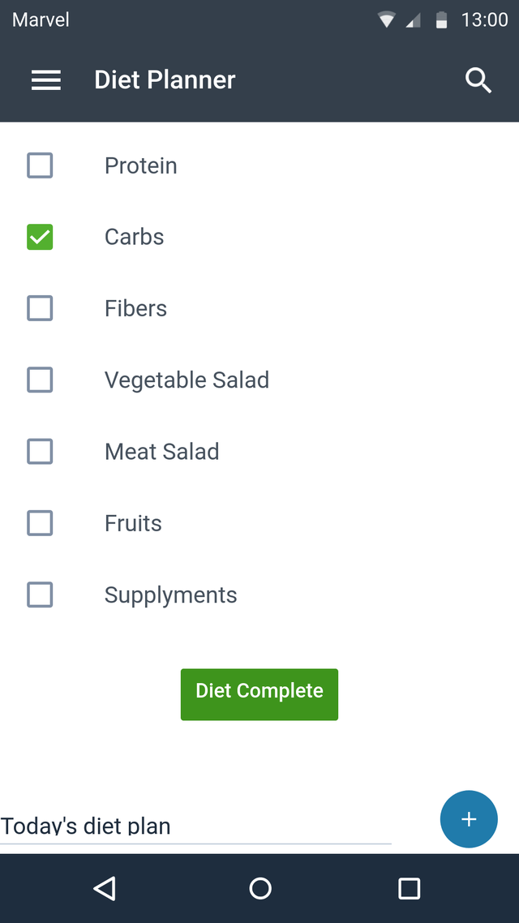
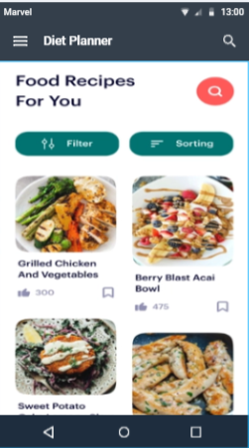
Diet Planner
Based on the individual health condition
Recommend the meal
Calculate calories
Send notification
Notes:
This screen shows the Diet planner part. Our diet planner will recommend meals based on each customer’s health condition. And will calculate the calories based on what you eat and how much you eat, and based on them, our app will send a notification if you still need some nutrients; for example, if you still need some protein, it will send the notification and will recommend you eat more egg or something else base on what you like to eat.

Slide 14


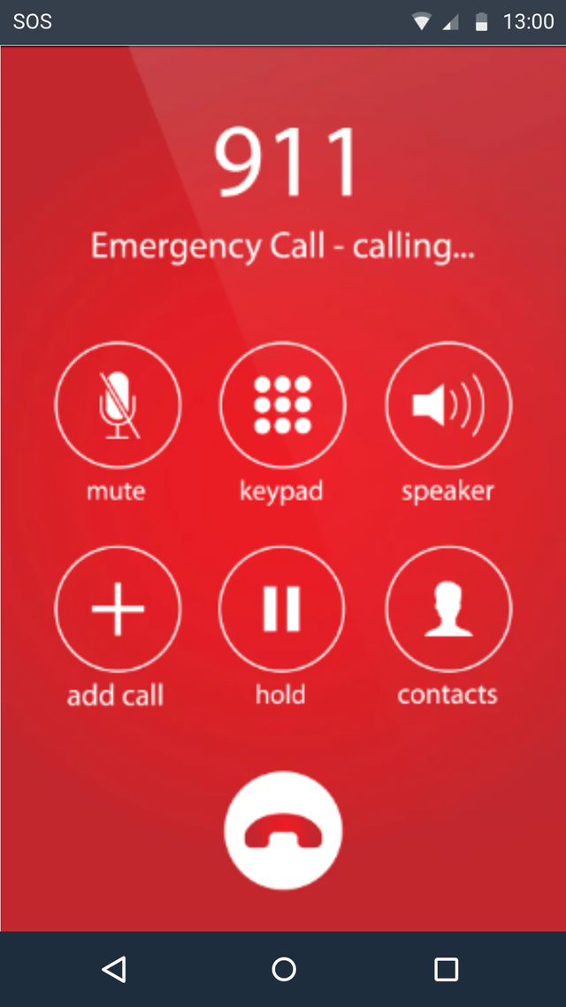

Share your current location
Sent your record to first responders
Connect with your health app
Connect with your smart device
https://marvelapp.com/prototype/e5g82i8
Notes:
Here is our emergency call part; if the user is in some emergency, the customer can use the button on our app to have an emergency call. And our app will share the user’s current location, record, and health information with the emergency department. Also, our app can connect with the user’s phone or smartwatch; for example, the latest iPhone has Crash Detection; if iPhone detects that the user is in a heavy crash situation, it will ask if you need any help or if the user didn’t respond in 20 seconds and was able to help the user to connect with an emergency, send the current location.

Slide 15

Questions?

Slide 16

Thank You

